Slide 1
WIND ENERGY SUPPLIER PITCH DECK
Here is where your presentation begins

Slide 2
CONTENTS OF THIS TEMPLATE
Here’s what you’ll find in this Slidesgo template:
A slide structure based on a pitch deck presentation, which you can easily adapt to your needs. For more info on how to edit the template, please visit Slidesgo School or read our FAQs.
An assortment of graphic resources that are suitable for use in the presentation can be found in the alternative resources slide.
A thanks slide, which you must keep so that proper credits for our design are given.
A resources slide, where you’ll find links to all the elements used in the template.
Instructions for use.
Final slides with:
The fonts and colors used in the template.
A selection of illustrations. You can also customize and animate them as you wish with the online editor. Visit Storyset to find more.
More infographic resources, whose size and color can be edited.
Sets of customizable icons of the following themes: general, business, avatar, creative process, education, help & support, medical, nature, performing arts, SEO & marketing, and teamwork.
You can delete this slide when you’re done editing the presentation

Slide 3
TABLE OF CONTENTS
01
Problem vs. solution
03
Our products
02
Market and competition
04
Business model
You can describe the
topic of the section here
You can describe the
topic of the section here
You can describe the
topic of the section here
You can describe the
topic of the section here

Slide 4
INTRODUCTION
Mercury is the closest planet to the Sun and the smallest one in the Solar System—it’s only a bit larger than our Moon. The planet’s name has nothing to do with the liquid metal since it was named after the Roman messenger god, Mercury

Slide 5
01
Problem vs. solution
You can enter a subtitle here if you need it

Slide 6
OUR COMPANY
Mercury is the closest planet to the Sun and the smallest one in the Solar System—it’s only a bit larger than our Moon. The planet’s name has nothing to do with the liquid metal since it was named after the Roman messenger god, Mercury

Slide 7


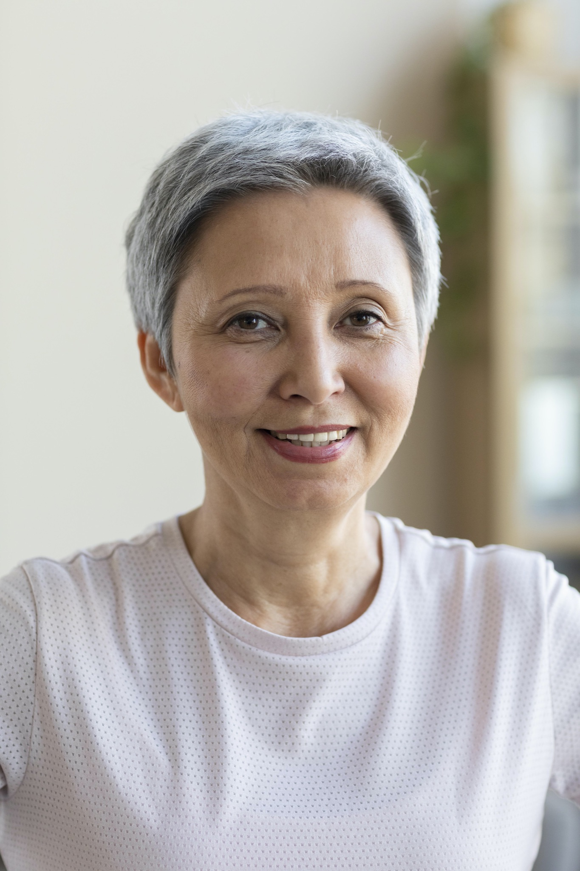
OUR TEAM
John James
Jenna Doe
Jane Patterson
You can replace the image on the screen with your own
You can replace the image on the screen with your own
You can replace the image on the screen with your own

Slide 8
PROBLEM
Mercury is the closest planet to the Sun and the smallest one in the Solar System—it’s only a bit larger than our Moon. The planet’s name has nothing to do with the liquid metal since it was named after the Roman messenger god, Mercury

Slide 9
Them
Us
Venus has a beautiful name and is the second planet from the Sun. It’s terribly hot—even hotter than Mercury
Mercury is the closest planet to the Sun and the smallest one in the Solar System—it’s only a bit larger than our Moon

Slide 10
SOLUTION
Venus has a beautiful name and is the second planet from the Sun. It’s terribly hot—even hotter than Mercury—and its atmosphere is extremely poisonous. It’s the second-brightest natural object in the night sky after the Moon

Slide 11
SWOT ANALYSIS
Mercury is the closest planet to the Sun
Jupiter is the biggest planet of them all
Mercury
Jupiter
S
W
O
T
Venus is the second planet from the Sun
Neptune is the farthest planet from the Sun
Venus
Neptune

Slide 12
PRODUCT OVERVIEW
Saturn
Venus
This is the ringed one. It’s a gas giant composed of
hydrogen and helium
Venus has a beautiful name, but extremely high temperatures. Its atmosphere is toxic

Slide 13
OUR PLANS
01
02
03
Basic
Pro
Premium
Saturn is a gas giant, composed mostly of hydrogen and helium
Jupiter is the biggest planet in the entire Solar System
Despite being red, Mars is a cold place full of iron oxide dust

Slide 14
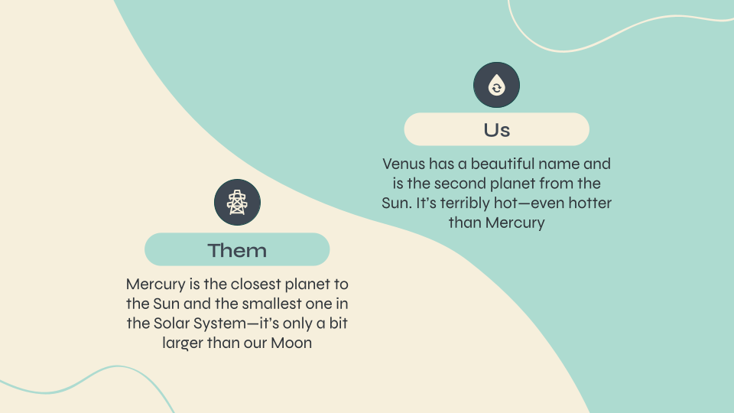
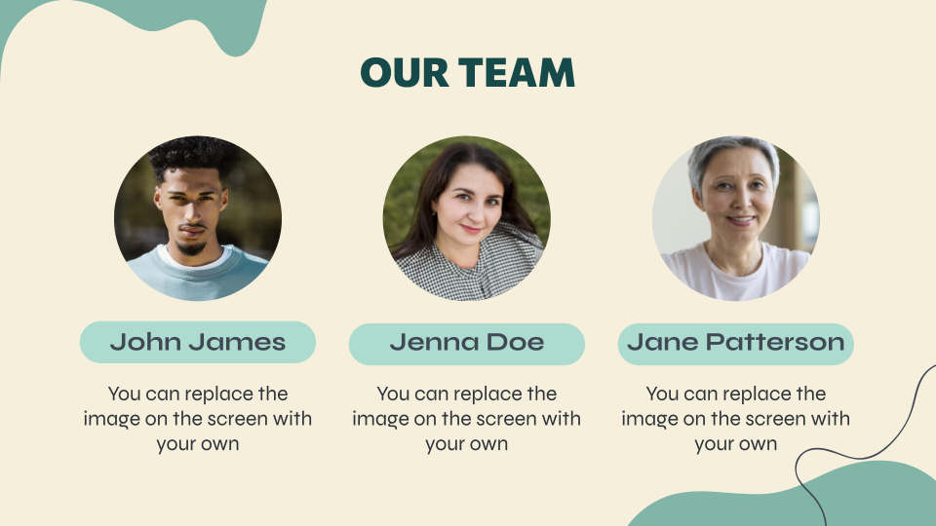
PRODUCT DEMO
You can replace the image on the screen with your own work. Right-click on it and then choose "Replace image" (in Google Slides) or "Change Picture" (in PPT) so you can add yours

Slide 15
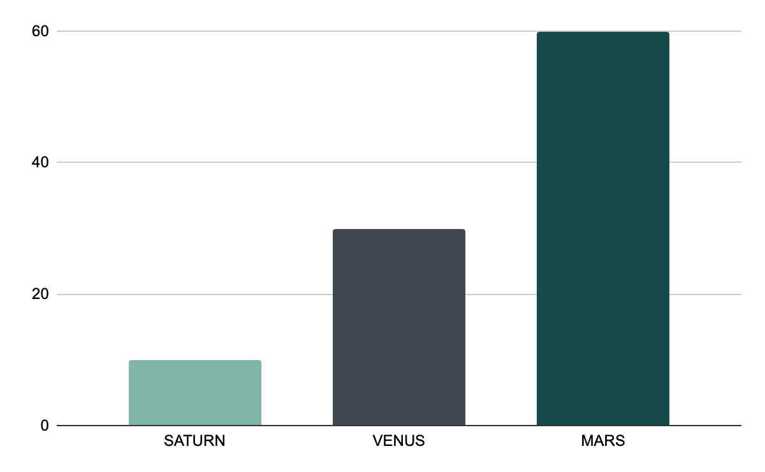
TRACTION
140,000
Gross revenue in 2021
12,000
10%
30%
60%
15
Average user savings per deal
Saturn is a gas giant, composed mostly of hydrogen and helium
Follow the link in the graph to modify its data and then paste the new one here. For more info, click here
Registered businesses
Total app downloads

Slide 16
CASE STUDY
Challenge
Results
Solution
Jupiter is the fourth-brightest object in the sky
Despite being red, Mars is a very cold place. The planet is full of iron oxide
Saturn is a gas giant composed mostly of hydrogen and helium

Slide 17
REVIEWS
Helena James
John Patterson
Mercury is the closest planet to the Sun and the smallest one in the Solar System—it’s only a bit larger than our Moon
Despite being red, Mars is a cold place, not hot. The planet is full of iron oxide dust, which gives the planet its reddish cast

Slide 18
AWARDS
2019
2020
Saturn is the ringed one. It’s a gas giant composed mostly of hydrogen and helium
Venus has a beautiful name and is the second planet from the Sun

Slide 19

MARKET SIZE
60%
Saturn
30%
Mars
10%
Venus
Saturn is a gas giant, composed mostly of hydrogen and helium
Despite being red, Mars is a very cold place full of iron oxide
Venus has a beautiful name and is the second planet from the Sun
Follow the link in the graph to modify its data and then paste the new one here. For more info, click here

Slide 20
TARGET
70%
30%
90%
10%
60%
20%
Hobbies
Gender
Hobbies
25 - 45 years
45 - 55 years
25 - 45 years
45 - 55 years
Saturn is a gas giant composed mostly of hydrogen and helium

Slide 21
COMPETITORS
Mercury
Mars
Venus
Jupiter
Mercury is the closest planet to the Sun and the smallest one in the Solar System
Despite being red, Mars is a cold place, not hot. The planet is full of iron oxide dust
Venus has a beautiful name and is the second planet from the Sun. It’s terribly hot
The biggest planet in the Solar System. It’s the fourth-brightest object in the sky

Slide 22
BUSINESS MODEL
Venus
Mercury
Mars
The second planet from the Sun. It’s terribly hot
Mercury is the closest planet to the Sun
Despite being red, Mars is a cold place

Slide 23
TIMING
Day 1
Day 2
Day 3
Day 4
Mercury is the closest planet to the Sun
Despite being red, Mars is a cold place
The Earth is the planet we all live on
Jupiter is the biggest planet

Slide 24
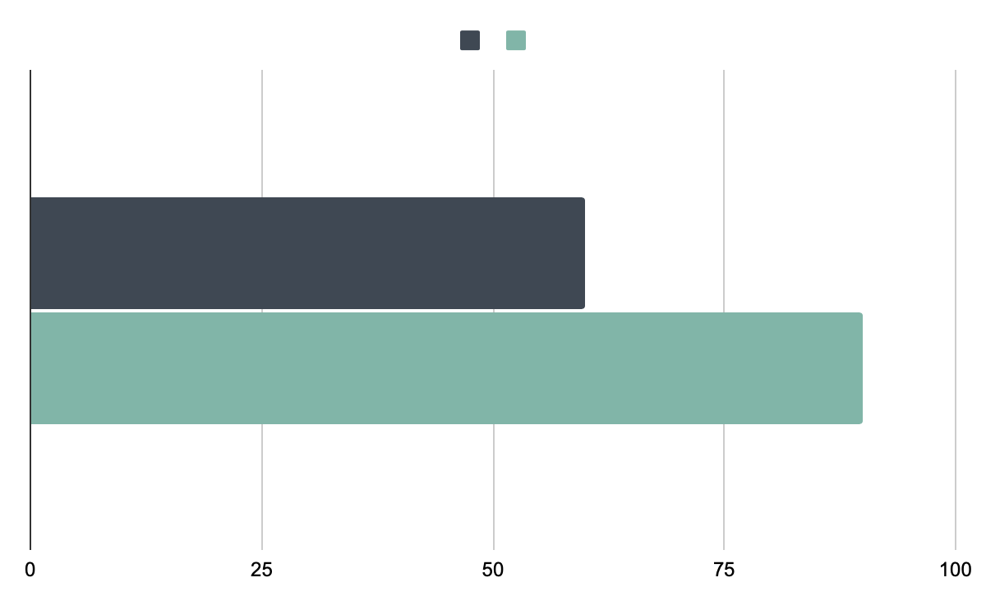
PREDICTED GROWTH
Mars
60%
90%
Jupiter
Despite being red, Mars is a cold place
The biggest planet in the Solar System
Follow the link in the graph to modify its data and then paste the new one here. For more info, click here

Slide 25

INVESTMENT
60%
40%
Mars
Venus
Despite being red, Mars is a cold place
It has extremely high temperatures
Follow the link in the graph to modify its data and then paste the new one here. For more info, click here

Slide 26
THE SLIDE TITLE GOES HERE!
Do you know what helps you make your point clear? Lists like this one:
They’re simple
You can organize your ideas clearly
You’ll never forget to buy milk!
And the most important thing: the audience won’t miss the point of your presentation

Slide 27
SIX COLUMNS
Mars
Venus
Neptune
Mars is actually a very cold place
It has extremely high temperatures
The farthest planet from the Sun
Mercury
Saturn
Jupiter
It’s the closest planet to the Sun
Saturn is the ringed one and a gas giant
Jupiter is the biggest planet of them all

Slide 28
AWESOME WORDS

Slide 29
—Someone Famous
“This is a quote. Words full of wisdom that someone important said and can make the reader get inspired.”

Slide 30
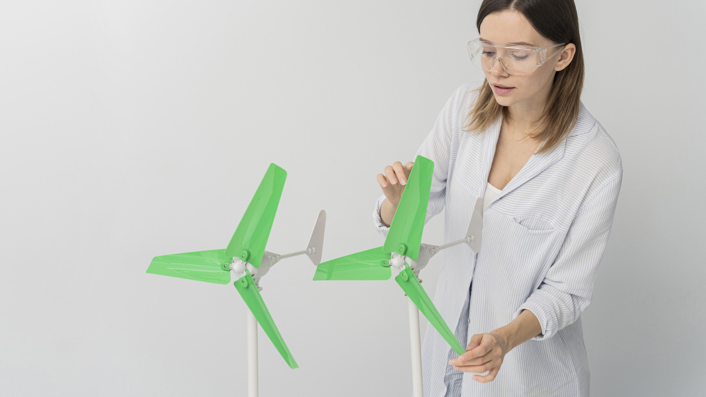
A PICTURE IS WORTH A THOUSAND WORDS

Slide 31
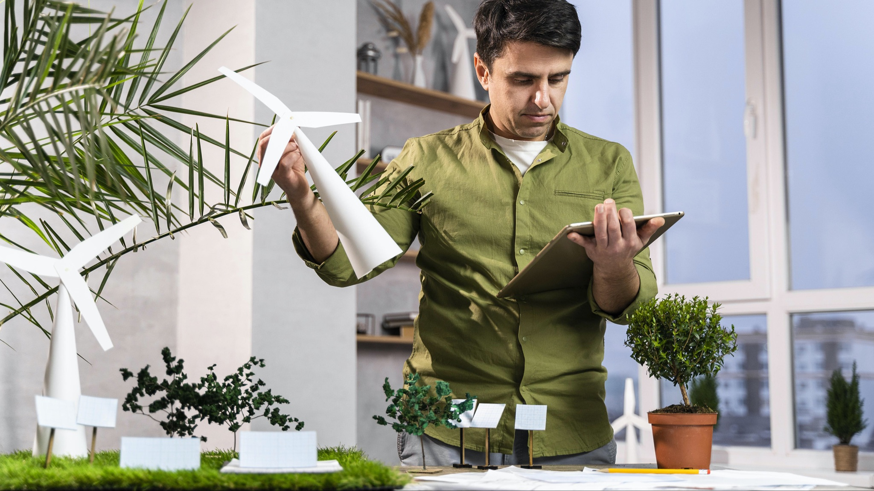
A PICTURE ALWAYS REINFORCES THE CONCEPT
Images reveal large amounts of data, so remember: use an image instead of a long text. Your audience will appreciate it

Slide 32
4,498
Big numbers catch your audience’s attention

Slide 33
24h 37m 23s
333,000,000
386,000 km
Is Jupiter's rotation period
Earths fit in the Sun’s mass
Distance between the Earth and the Moon

Slide 34
THE TABLES
City | Population |  | Wind and solar share of electricity mix |  | Renewable share of electricity mix (2021)
Sweden | 156,000 |  | 100% |  | 83%
United States | 139,000 |  | 90% |  | 75%
India | 52,000 |  | 70% |  | 65%
Australia | 1,300,000 |  | 65% |  | 60%
Spain | 3,260,000 |  | 95% |  | 90%

Slide 35
THIS IS A MAP
Venus
Jupiter
Venus has a beautiful name and is the second planet from the Sun. It’s terribly hot
The biggest planet in the Solar System. Jupiter is the fourth-brightest object in the sky

Slide 36
THANKS!
Does anyone have any questions?
addyouremail@freepik.com
+91 620 421 838
yourcompany.com
Please keep this slide for attribution

Slide 37
RENEWABLE ENERGY ICON PACK

Slide 38
ALTERNATIVE RESOURCES

Slide 39
RESOURCES
Photos
Vectors
Man using tablet for an eco project
Woman showing wind energy innovation
Portrait of brunette smiley woman
Portrait of mature woman smiling
Young man posing outdoor
Renewable energy icon pack
Zero waste landing page
Abstract organic shapes banners
Technology devices
Icon

Slide 40
Instructions for use
In order to use this template, you must credit Slidesgo by keeping the Thanks slide.
You are allowed to:
- Modify this template.
- Use it for both personal and commercial projects.
You are not allowed to:
- Sublicense, sell or rent any of Slidesgo Content (or a modified version of Slidesgo Content).
- Distribute Slidesgo Content unless it has been expressly authorized by Slidesgo.
- Include Slidesgo Content in an online or offline database or file.
- Offer Slidesgo templates (or modified versions of Slidesgo templates) for download.
- Acquire the copyright of Slidesgo Content.
For more information about editing slides, please read our FAQs or visit Slidesgo School:
https://slidesgo.com/faqs and https://slidesgo.com/slidesgo-school

Slide 41
Instructions for use (premium users)
As a Premium user, you can use this template without attributing Slidesgo or keeping the "Thanks" slide.
You are allowed to:
Modify this template.
Use it for both personal and commercial purposes.
Hide or delete the “Thanks” slide and the mention to Slidesgo in the credits.
Share this template in an editable format with people who are not part of your team.
You are not allowed to:
Sublicense, sell or rent this Slidesgo Template (or a modified version of this Slidesgo Template).
Distribute this Slidesgo Template (or a modified version of this Slidesgo Template) or include it in a database or in any other product or service that offers downloadable images, icons or presentations that may be subject to distribution or resale.
Use any of the elements that are part of this Slidesgo Template in an isolated and separated way from this Template.
Register any of the elements that are part of this template as a trademark or logo, or register it as a work in an intellectual property registry or similar.
For more information about editing slides, please read our FAQs or visit Slidesgo School:
https://slidesgo.com/faqs and https://slidesgo.com/slidesgo-school

Slide 42
Fonts & colors used
This presentation has been made using the following fonts:
Commissioner
(https://fonts.google.com/specimen/Commissioner)
Syne
(https://fonts.google.com/specimen/Syne)
#2e3338
#f6efdc
#164a4a
#3f4853
#81b5a8
#454318
#ffffff
#addbd0

Slide 43





Storyset
Create your Story with our illustrated concepts. Choose the style you like the most, edit its colors, pick the background and layers you want to show and bring them to life with the animator panel! It will boost your presentation. Check out How it Works.
Pana
Amico
Bro
Rafiki
Cuate

Slide 44
Use our editable graphic resources...
You can easily resize these resources without losing quality. To change the color, just ungroup the resource and click on the object you want to change. Then, click on the paint bucket and select the color you want. Group the resource again when you’re done. You can also look for more infographics on Slidesgo.

Slide 47
JANUARY
FEBRUARY
MARCH
APRIL
MAY
JUNE
PHASE 1
Task 1
Task 2
PHASE 2
Task 1
Task 2
JANUARY
FEBRUARY
MARCH
APRIL
PHASE 1
Task 1
Task 2

Slide 50
...and our sets of editable icons
You can resize these icons without losing quality.
You can change the stroke and fill color; just select the icon and click on the paint bucket/pen.
In Google Slides, you can also use Flaticon’s extension, allowing you to customize and add even more icons.

Slide 51
Educational Icons
Medical Icons

Slide 52
Business Icons
Teamwork Icons

Slide 53
Help & Support Icons
Avatar Icons

Slide 54
Creative Process Icons
Performing Arts Icons

Slide 55
Nature Icons

Slide 56
SEO & Marketing Icons

Slide 57


